Slide 1


Data Science Essentials
Module: Data Science Essentials
Course: Higher Diploma in Software Engineering/Bachelor Degree in Software Engineering
Start Date :
End Date : Submission Date :
Learner Name Enrollment ID
:Muhammad Kemal
:bdse07-0922-084
Presentation Date :

Slide 2
Document History
Version Number | Effective Date of release | Summary of Included Changes | Author
1 | 23rd April 2022 | First Edition

Slide 3
Contents
S. No. | Description
01 | Problem Statement
02 | Project Objectives
03 | Project Milestones & Tasks
04 | Data Analytics, BI and Data Science
05 | Data Types
06 | Select Data Analytics Tool
07 | Implementation Results: put evidence for each level and highlight problem with solution
08 | DAX functions if used (Optional)
09 | Milestone Feedback & Action
10 | Future Improvements

Slide 4
1. Problem Statement
Our company faces the challenge of a high employee turnover rate, impacting recruitment costs and overall organizational productivity. Previously, a lack of visibility and inefficient data analysis hindered the HR team from understanding the causes and trends of attrition. To address these issues, we designed an HR Attrition Dashboard in Power BI. The dashboard aims to provide clear visibility, identify turnover causes, and support decision-making for more proactive retention strategies. Thus, we hope this dashboard not only addresses turnover issues but also enables more effective human resources management.

Slide 5
2. Project Objectives
The project objectives for the HR Attrition Dashboard revolve around enhancing visibility into employee turnover trends, identifying key drivers of attrition, and establishing a foundation for proactive retention strategies. Cost analysis and reduction, along with the creation of a user-friendly interface, are prioritized to ensure accessibility and comprehension for the HR team and stakeholders. The inclusion of real-time monitoring capabilities aims to provide timely insights for swift responses to changes in turnover patterns. Ultimately, the project's goal is to improve decision-making within the HR team by delivering pertinent data and insights, facilitating more effective strategies to manage and mitigate employee attrition.

Slide 6
3. Project Milestones & Tasks
Project Task ID | Project Task Description | Project Milestone ID
1 | Project Initiation and Requirement Gathering | 1
2 | Data Analytics, BI and Data Science | 2
3 | Data Types | 3
4 | Data Analytics tools and techniques | 4
5 | Dashboard Development | 5
6 | Data Analytics | 6
7 | Evaluation | 7

Slide 7
4. Data Analytics, BI and Data Science
Data Analytics: In the context of Data Analytics, we focus on the process of analyzing data to gain valuable insights. It involves understanding and determining relationships in digital data through detailed examination to understand its essential properties or features.
Business Intelligence (BI): Business Intelligence (BI) is the foundation for collecting, analyzing, and visualizing business data. We use BI to provide deep insights through development dashboards, data visualizations, and reports to support strategic decision making.
Data Science: Data Science dalam konteks kami melibatkan keterampilan dan teknik untuk menganalisis dan menafsirkan data kompleks. Di sini, peran Data Science muncul dalam pengembangan model prediktif, identifikasi pola rumit, dan menghasilkan wawasan mendalam yang mendukung pengambilan keputusan.

Slide 8
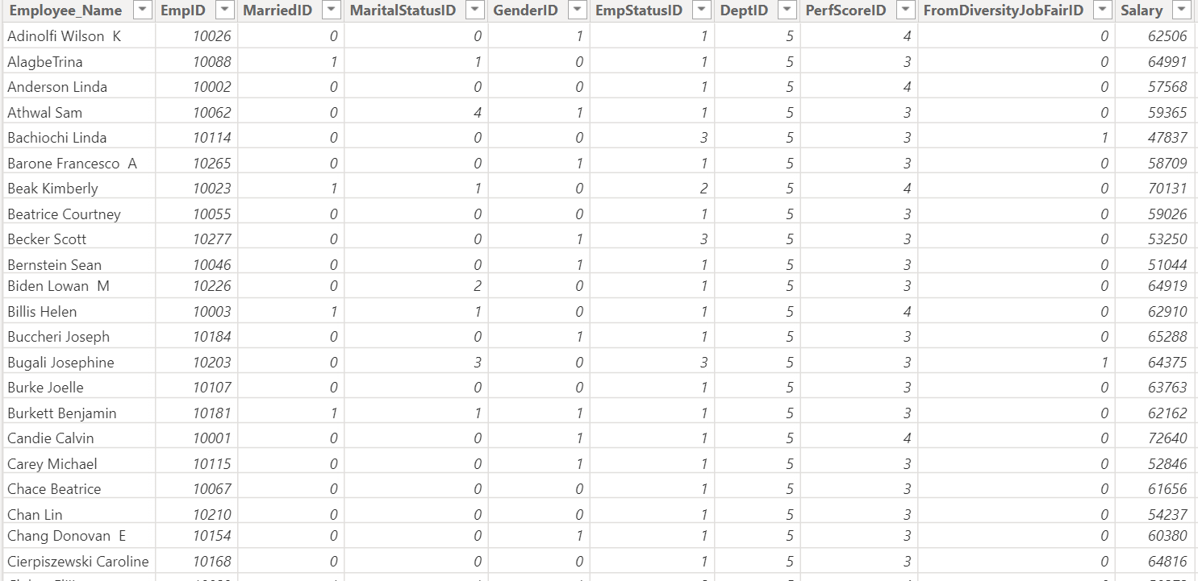
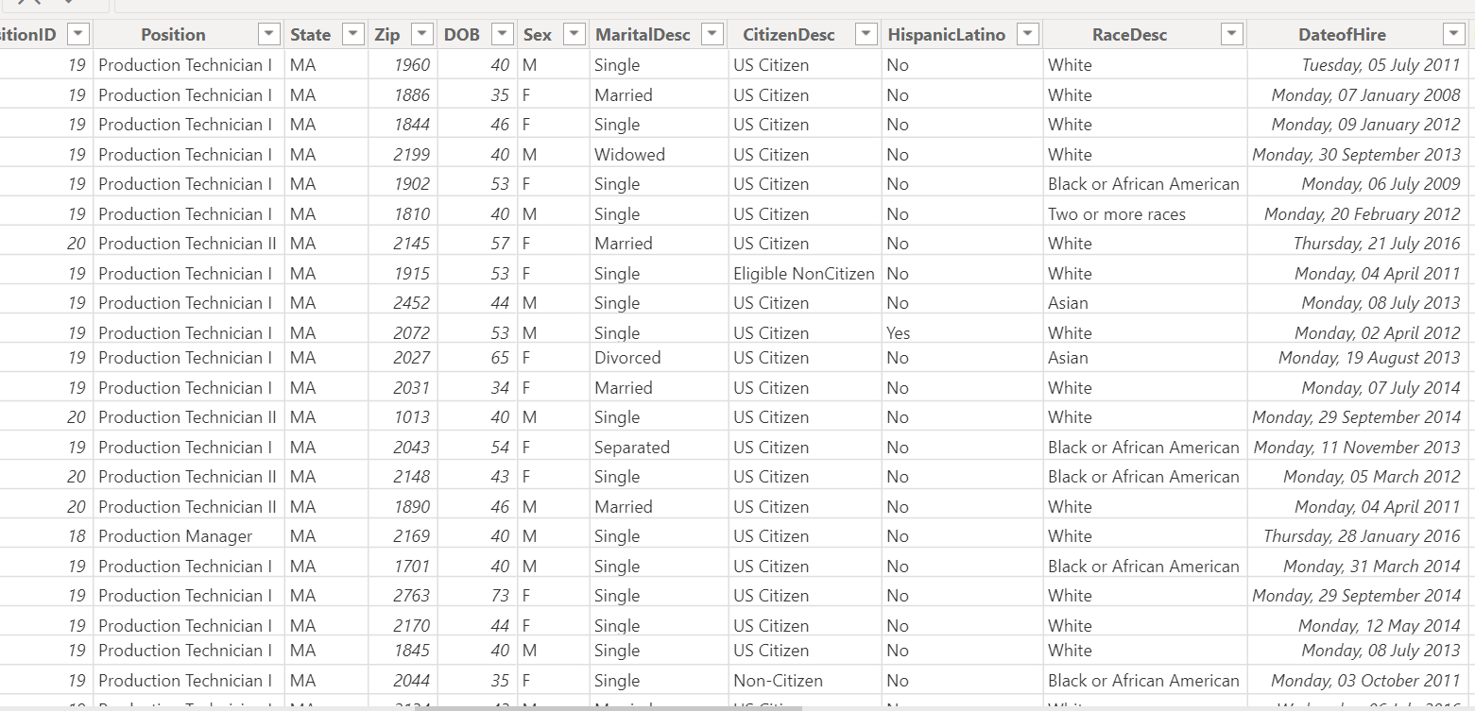
5. Data Types

Slide 9


6. Select Data Analytics Tool
Tools Used
As the primary data analysis platform, Microsoft Power BI is used to connect, combine, and analyze data from various sources. Its main advantage lies in its ability to create dynamic and interactive data visualizations, enabling better understanding of employee attrition trends and patterns. With Power BI, I can present information in a way that is engaging and easy to understand for various stakeholders.
Microsoft Excel remains an important tool in this project. Used for initial data processing and preparation, Excel provides great flexibility in data manipulation and filtering. Additionally, powerful analysis functions in Excel allow for initial exploration before data is imported into Power BI. The combination of these two tools ensures good data integration and in-depth analysis in employee attrition management projects

Slide 10
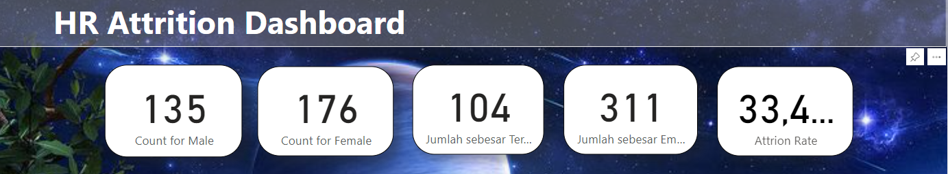
7. Implementation Results

Slide 11
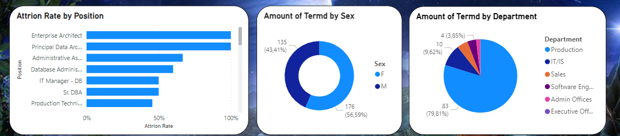
7. Implementation Results

Slide 12
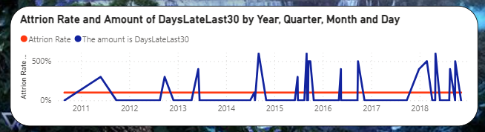
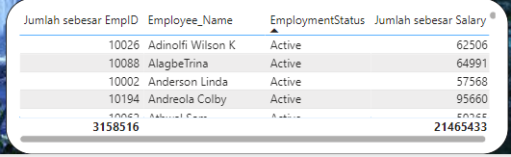
7. Implementation Results

Slide 13
8. DAX functions if used (Optional)

Slide 14
9. Milestone Feedback & Action
Milestones:
We successfully completed the initial data analysis phase, which involved extracting, cleaning, and modeling the data required to form the basis of the attrition dashboard.
With this accomplished, the next steps are to focus on creating additional, more detailed visualizations, exploring specific factors that contribute to attrition, and preparing the project for the implementation phase.

Slide 15
10. Future Improvements
Include a plan to integrate additional data sources that might enrich the attrition analysis, such as individual performance data, customer feedback, or external factors that could be influential.
In terms of design, I want to present a more interesting display and I also want to learn more about data analysis, so that I can identify and create satisfying results.

Slide 16
THANK YOU

